Slide 1
Addis Ababa Science and Technology University
Department of Software Engineering
Fundamentals of Database Systems
ch-1Slide
Lecturer: Yaynshet.M

Slide 2
Data base systems:
manage large data sets in an organization
definition and the manipulation of the data
Provide mechanisms for the manipulation of information
maintain internal records, to present data to customers and clients on the Www.
Data base
found at the core of many modern organizations
Represented in specialized software called a database management system, or DBMS.
A DBMS is a powerful tool for creating and managing large amounts of data efficiently and allowing it to continue over long periods of time, safely.
database refers to a collection of data that is managed by a DBMS

Slide 3
DB course is about:
How to organize data
Supporting multiple users
Efficient and effective data retrieval
Secured and reliable storage of data
Maintaining consistent data
Making information useful for decision making
Data management
passes through the different levels of development along with the development in technology and services.

Slide 4
Manual Approach
Traditional File Based Approach
Database Approach
Manual Approach
data storage and retrieval is performed by using cards, cabinets/shelf , paper using human labor.

Slide 5
Manual approach
the file is labeled and stored in one or more cabinets.
security
The cabinets could be kept in safe places for security purpose based on the sensitivity of the information contained in it.
Insertion and retrieval
done by searching first for the right cabinet then for the right the file then the information Or by indexing/listing

Slide 6
Manual approach
Limitations
Prone to error
Difficult to update, retrieve, integrate
You have the data but it is difficult to compile the information
Limited to small size information
Cross referencing is difficult

Slide 7
Traditional File Based Approach
After introduction of Computers for data processing to the business community
A need to use the Computers for data storage and processing increase.
attempt to computerize the manual filing system
A collection of application programs perform services for the end-users.
every application program that provides service to end users define and manage its own data

Slide 8
Traditional File Based Approach
Since every application defines and manages its own data, the system is subjected to serious data duplication problem.
Such systems have number of programs for each of the different applications in the organization.

Slide 9
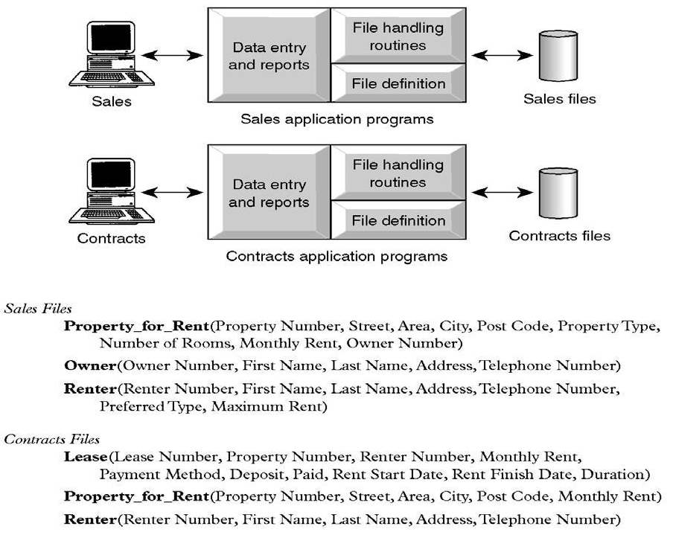

Slide 10
Traditional File Based Approach
Limitations
Separation or Isolation of Data: Available information in one application may not be known.
Limited data sharing
Lengthy development and maintenance time
Duplication or redundancy of data
Data dependency on the application
Incompatible file formats between different applications and programs creating inconsistency.
Fixed query processing which is defined during application development

Slide 11
Traditional File Based Approach
The limitations arise from two basic reasons.
Definition of the data is embedded in the application program which makes it difficult to modify the database definition easily.
No control over the access and manipulation of the data beyond that imposed by the application programs.

Slide 12
Traditional File Based Approach
The most significant problem
Modification Anomalies: a problem experienced when one or more data value is modified on one application program but not on others containing the same data set.
Deletion Anomalies: a problem encountered where one record set is deleted from one application but remain untouched in other application programs.
Insertion Anomalies: a problem experienced whenever there is new data item to be recorded, and the recording is not made in all the applications

Slide 13
Database Approach
Tedd Codd proposed that database systems should present the user with a view of data organized as tables called relations.
Behind the scenes, there might be a complex data structure that allowed rapid response to a variety of queries.
But, unlike the user of earlier database systems, the user of a relational system would not be concerned with the storage structure
Queries could be expressed in a very high-level language, which greatly increased the efficiency of database programmers.

Slide 14
Database Approach
The database approach emphasizes the integration and sharing of data throughout the organization.
a computerized record keeping system or a kind of electronic filing cabinet.
a repository for collection of computerized data files.
a shared collection of logically related data designed to meet the information needs of an organization.

Slide 15
Database Approach
a collection of logically related data where these logically related data comprises entities, attributes, relationships, and business rules of an organization's information.
In addition to containing data required by an organization, database also contains a description of the data which called as “Metadata”

Slide 16
Database Approach
The purpose of a database is to store information and to allow users to retrieve and update that information on demand.
Database is deigned once and used simultaneously by many users.
Unlike the traditional file based approach in database approach there is program data independence.
That is the separation of the data definition from the application.
Thus the application is not affected by changes made in the data structure and file organization.
Each database application will perform the combination of: Creating database, Reading, Updating and Deleting data.

Slide 17
Database Approach
Benefits
Data can be shared: two or more users can access and use same data instead of storing data in redundant manner for each user.
Improved accessibility of data: by using structured query languages, the users can easily access data without programming experience.
Redundancy can be reduced: isolated data is integrated in database to decrease the redundant data stored at different applications.
Quality data can be maintained: the different integrity constraints in the database approach will maintain the quality leading to better decision making
Inconsistency can be avoided: controlled data redundancy will avoid inconsistency of the data in the database to some extent.

Slide 19
Database Approach
Limitations and risks
Introduction of new professional and specialized personnel.
Complexity in designing and managing data
The cost and risk during conversion from the old to the new system
High cost to be incurred to develop and maintain the system
Complex backup and recovery services from the users perspective
Reduced performance due to centralization and data independency
High impact on the system when failure occurs to the central

Slide 20
Database Management System (DBMS)
Data storage, retrieval and update in the database
A user accessible catalogue
Transaction support service: ALL or NONE transaction, which minimize data inconsistency.
Concurrency Control Services: access and update on the database by different users simultaneously should be implemented correctly.
Recovery Services: a mechanism for recovering the database after a failure must be available.
Authorization Services (Security): must support the implementation of access and authorization service to database administrator and users.
Support for Data Communication: should provide the facility to integrate with data transfer software or data communication managers.
Integrity Services: rules about data and the change that took place on the data, correctness

Slide 21
DBMS
Components
Data Definition Language (DDL):
Language used to define each data element required by the organization.
Commands for setting up schema or the intension of database
These commands are used to setup a database, create, delete and alter table with the facility of handling constraints
Data Manipulation Language (DML):
Is a core command used by end-users and programmers to store, retrieve, and access the data in the database e.g. SQL
Since the required data or Query by the user will be extracted using this type of language, it is also called "Query Language"
Data Dictionary:
Due to the fact that a database is a self-describing system, this tool, Data Dictionary, is used to store and organize information about the data stored in the database.

Slide 22
Components
Data Control Language:
Database is a shared resource that demands control of data access and usage. The database administrator should have the facility to control the overall operation of the system.
Data Control Languages are commands that will help the Database Administrator to control the database.
The commands include grant or revoke privileges to access the database or particular object within the database and to store or remove database transactions

Slide 23
DBMS Environment
The DBMS environment has five components. To design and use a database, there will be the interaction or integration of Hardware, Software, Data, Procedure and People.

Slide 24
DBMS Environment
Components
Hardware:
are components that one can touch and feel.
These components are comprised of various types of personal computers, mainframe or any server computers to be used in multi-user system, network infrastructure, and other peripherals required in the system.

Slide 25
DBMS Environment
Components
Software:
are collection of commands and programs used to manipulate the hardware to perform a function.
These include components like the DBMS software, application programs, operating systems, network software, language software and other relevant software.

Slide 26
DBMS Environment
Components
Data:
since the goal of any database system is to have better control of the data and making data useful, Data is the most important component to the user of the database.
There are two categories of data in any database system: that is Operational and Metadata.
Operational data is the data actually stored in the system to be used by the user.
Metadata is the data that is used to store information about the database itself.
The structure of the data in the database is called the schema, which is composed of the Entities, Properties of entities, and relationship between entities.

Slide 27
DBMS Environment
Component
Procedure:
this is the rules and regulations on how to design and use a database.
It includes procedures like how to log on to the DBMS, how to use facilities, how to start and stop transaction, how to make backup, how to treat hardware and software failure, how to change the structure of the database.

Slide 28
DBMS Environment
Components
People:
this component is composed of the people in the organization that are responsible or play a role in designing, implementing, managing, administering and using the resources in the database.
This component includes group of people with high level of knowledge about the database and the design technology to other with no knowledge of the system except using the data in the database.

Slide 29
Database Development Life Cycle
Planning: that is identifying information gap in an organization and propose a database solution to solve the problem.
Analysis: that concentrates more on fact finding about the problem or the opportunity.
Feasibility analysis, requirement determination and structuring, and selection of best design method are also performed at this phase.
Design: in database designing more emphasis is given to this phase.
The phase is further divided into three sub-phases

Slide 30
Database Development Life Cycle
Design
Conceptual Design: short description of the data, data type, relationship between data and constraints on the data.
There is no implementation or physical detail consideration.
Used to elicit and structure all information requirements
Logical Design: a higher level conceptual abstraction with selected specific data model to implement the data structure.
It is particular DBMS independent and with no other physical considerations.
Physical Design: physical implementation of the upper level design of the database with respect to internal storage and file structure of the database for the selected DBMS.
To develop all technology and organizational specification.

Slide 31
Database Development Life Cycle
Implementation: the testing and deployment of the designed database for use
Operation and Support: administering and maintaining the operation of the database system and providing support to users.

Slide 32
Roles in Database Design and Use
1. Database Administrator (DBA)
Responsible to oversee, control and manage the database resources (the database itself, the DBMS and other related software)
Authorizing access to the database
Coordinating and monitoring the use of the database
Responsible for determining and acquiring hardware and software resources
Accountable for problems like poor security, poor performance of the system
Involves in all steps of database development

Slide 33
Roles in Database Design and Use
Database Administrator (DBA)
further classifications
Data Administrator (DA): is responsible on management of data resources. Involves in database planning, development, maintenance of standards policies and procedures at the conceptual and logical design phases.
Database Administrator (DBA): is more technically oriented role. Responsible for the physical realization of the database. Involves in physical design, implementation, security and integrity control of the database.

Slide 34
Roles in Database Design and Use
2. Database Designer (DBD)
Identifies the data to be stored and choose the appropriate structures to represent and store the data.
Should understand the user requirement and should choose how the user views the database.
Involve on the design phase before the implementation of the database system.
We have two distinctions of database designers, one involving in the logical and conceptual design and another involving in physical design.

Slide 35
Roles in Database Design and Use
Database Designer (DBD)
Logical and Conceptual DBD
Identifies data (entity, attributes and relationship) relevant to the organization
Identifies constraints on each data
Understand data and business rules in the organization
Sees the database independent of any data model at conceptual level and consider one specific data model at logical design phase.

Slide 36
Roles in Database Design and Use
Database Designer (DBD)
Physical DBD
Take logical design specification as input and decide how it should be physically realized.
Map the logical data model on the specified DBMS with respect to tables and integrity constraints. (DBMS dependent designing)
Select specific storage structure and access path to the database
Design security measures required on the database

Slide 37
Roles in Database Design and Use
3. Application Programmer and Systems Analyst
System analyst determines the user requirement and how the user wants to view the database.
The application programmer implements these specifications as programs; code, test, debug, document and maintain the application program.
Determines the interface on how to retrieve, insert, update and delete data in the database.
The application could use any high level programming language according to the availability, the facility and the required service.

Slide 38
Roles in Database Design and Use
4. End Users Workers, whose job requires accessing the database frequently for various purpose. There are different group of users in this category.
Naïve Users:
Sizable proportion of users
Unaware of the DBMS
Only access the database based on their access level and demand
Use standard and pre-specified types of queries.

Slide 39
Roles in Database Design and Use
End users
Sophisticated Users
Are users familiar with the structure of the Database and facilities of the DBMS.
Have complex requirements
Have higher level queries
Are most of the time engineers, scientists, business analysts, etc
Casual Users
Users who access the database occasionally.
Need different information from the database each time.
Use sophisticated database queries to satisfy their needs.
Are most of the time middle to high level managers.

Slide 40
Roles in Database Design and Use
End users
These users can be again classified as “Actors on the Scene” and “Workers Behind the Scene”.
Actors on the Scene:
Data Administrator
Database Administrator
Database Designer
End Users

Slide 41
Roles in Database Design and Use
End users
Workers behind the Scene
DBMS designers and implementers: who design and implement different DBMS software.
Tool Developers: experts who develop software packages that facilitates database system designing and use.
Prototype, simulation, code generator developers could be an example. Independent software vendors could also be categorized in this group
Operators and Maintenance Personnel: system administrators who are responsible for actually running and maintaining the hardware and software of the database system and the information technology facilities.

Slide 42
Go to
Syllabus
Chapter Two
Chapter Three
Chapter Four
Chapter Five

